Slide 1


The FSU School of Communication Science & Disorders
CERTIFICATE IN INTERDEPARTMENTAL DEVELOPMENTAL DISABILITIES

Slide 2
OVERVIEW OF THE PROGRAM
The certificate program provides students with a foundation of knowledge regarding etiology, treatment and policy issues related to individuals with developmental disabilities and their families through a 12-credit hour certificate program.
The certificate provides background knowledge for careers in professions such as education, communication science and disorders, physical therapy, occupational therapy, family counseling and nursing.
The certificate is open to all majors.
  Currently we have students completing the certificate who are perusing careers in Speech-Language Pathology, Audiology, Social Work, Psychology, Occupational Therapy, Physical Therapy, Applied Behavior Therapy, Music Therapy, Nursing, and Education.

Slide 3
Certificate Student Outcomes
Apply knowledge of ethical conduct and professionalism through participation in a community service agency as a volunteer to support individuals with developmental disabilities.
Demonstrate effective communication skills appropriate to the setting with other children, individuals and professionals.
Identify a variety of resources and types of treatments for individuals with developmental disabilities and their families.
Discuss the opportunities and challenges of people with developmental disabilities.

Slide 4
Applying to the Certificate
Students must submit their application BEFORE the end of their second course towards the certificate.
The registrar will no longer approve students applying for the certificate AFTER taking their second course because of a University rule. This ensures that students who complete the practicum will have their certificate posted on their transcript.
Once students have submitted their application the DDCertificate@cci.fsu.edu will send an email to confirm the students expected practicum term. This ensures that there are enough seats for the class and placements in the community.
Students who do not confirm their expected practicum term will have limited options to complete their practicum. So the sooner students can confirm their practicum term the better!
Students who switch their expected practicum semester closer to their expected graduation cannot be guaranteed a seat.
Apply online at: https://commdisorders.cci.fsu.edu/programs/certificates/interdepartmental-developmental-disabilities/#program-application

Slide 5
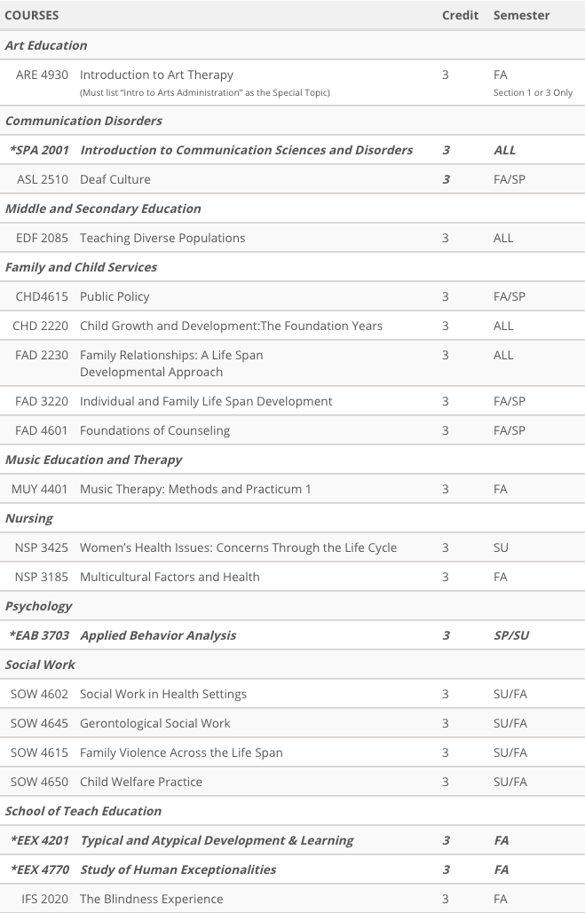
Required Coursework
Students must first complete twelve (12) credit hours to include:
  A core course (3 hours)
  Two elective courses (6 hours)
  Participation in a practicum course (3 hours).
Approved courses can be found on: https://commdisorders.cci.fsu.edu/programs/certificates/interdepartmental-developmental-disabilities/#courses
Coursework must be completed with at least a B or higher.

Slide 6
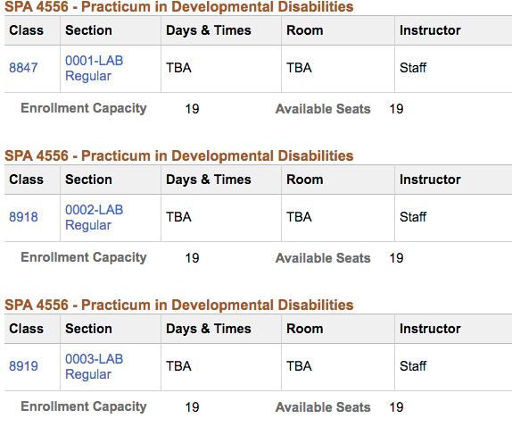
Enrolling into the Practicum
Students must receive an email from DDCertificate@cci.fsu.edu to enroll into the course during open enrollment.
Students who have not received an email with the practicum course code will be dropped.
Students will also receive information regarding requirements/clearances that must be completed to start at their assigned site. This information will be sent closer to the start of the student’s expected practicum term.

Slide 7
Community Experience (Practicum)
The three (3) credit hour practicum course is comprised of 45 hours of volunteer service-learning hours to be completed at an off-campus placement with individuals with developmental disabilities. 3-5 hours of volunteer service will be expected for each of the 15 weeks of the semester. The practicum must be completed over a full semester (Fall, Spring, or Summer Session A only).
Students select whether they want to work with children, adults, or if they have no preference when applying.
Based on their population preference they will be placed at site in Tallahassee.
Students cannot participate in the practicum until all prerequisite coursework is completed.

Slide 8
Student FAQ’s
Students are not allowed to select their placement site. Sites are only in Tallahassee.
Students are not allowed to complete required coursework at the same time as their practicum.
Students who received a B or below on their required coursework can retake or choose a different course from the approved course list.
Students studying abroad will not be able to complete their practicum during the same summer.
The summer semester is Session C (the entire semester).
Students who are put on a waitlist for a practicum term cannot be guaranteed a seat.

Slide 9
QUESTIONS?
Contact
DDCertificate@cci.fsu.edu
MOLLIE.ROMANO@CCI.FSU.EDu
WEBSITE
https://commdisorders.cci.fsu.edu/programs/certificates/interdepartmental-developmental-disabilities/

